Slide 1
Determinations and Interpretations of FTIR Detection Limits
Curtis T. Laush, Ph.D.
Geosyntec Analytical Measurements Group, 8217 Shoal Creek Blvd., Suite 200, Austin, TX 78757
claush@geosyntec.com; phone, 512-354-3287

Slide 2
Why Determine and Minimize Field Detection Limits (FDLs) Regardless of Measurement Method?
Need to know what “zero emissions” mean for target pollutants under study
    How do “BDLs” get treated?
    The lower FDLs can accurately be, the less significant this question becomes
Increase dynamic field measurement range of instrument
    And more accurate calibration curves can be generated
Increase accuracy of measurement for low-level emitters
    Better signal-to-noise and less baseline artifact interferences across the integrated absorbance band(s) lead to better fit with calibration spectra
Results in better emissions modeling and inventories
    Better monitoring/understanding of emission chemistries

Slide 3
EPA Method 320 vs. Standard Test Method ASTM D6348-12
Both ask for pre-test “minimum detection limit (MDL, aka MDC)” estimates
    Both based on RMS (instrumental or analytical) noise of an analytical region and the absorptivity of the analyte in the same region
    These DLs are always best-case and usually idealistic
Both suggest field verification of actual FDLs via analyte spiking methods
    They suggest spiking as low as 2-3 times MDLs
    When done properly, actual field measurement accuracies and FDLs are empirically determined; they apply as long as the spectral interference matrix did not significantly change between the analyte spiking events
ASTM D6348-12 suggests further calculating post-test MDL estimates
    Presumably, observed spectral interferences within the sample matrix caused changes in the analytical method, also changing the MDLs
    This provides good estimates of “analyte zeros” because now actual field spectra (possessing all other interferants/pollutants) are used in the RMS analyses

Slide 4
Example of a Field Gas Spiking and Sampling
Configuration for Periodic Validations
PFA Teflon sample tubing
Enhanced FTIR
Sample Cell
Stack, exhaust or
ambient air source
0-5 lpm
MFM
Sample Pump
0-1 lpm
MFC
Certified Gas
Standard in
Cylinder
(100 ppb each of mixed VOCs in UHP nitrogen balance)

Slide 5
Some FDL Validations

Slide 6
Analyte Spiking Surrogates?
Obtaining an actual FDL of each zero analyte requires a certified gas standard for each zero pollutant
    There may be too many or some are too reactive or nonvolatile to handle in gas cylinders
    Elaborate “laboratory assemblies” can be field implemented if the pollutants are critical to empirically determine and the chemicals can be handled
What about chemical surrogates?
    Method 301/320 mentions their use
    If similar enough in chemical reactivities to the target analytes in question, they may be serviceable in validating recoveries of the sample gas extraction assembly
    Because FTIR completely speciates the quantitative analyses of all pollutants, the use of surrogates is not technically acceptable in analytical method data QA/QC procedures (validating accuracies, precisions, etc.) where calibrations are being validated
    BUT, they could possibly be serviceable in estimating FDLs IF calibration differences are factored, analysis regions are close and spectral “shapes” are similar

Slide 7
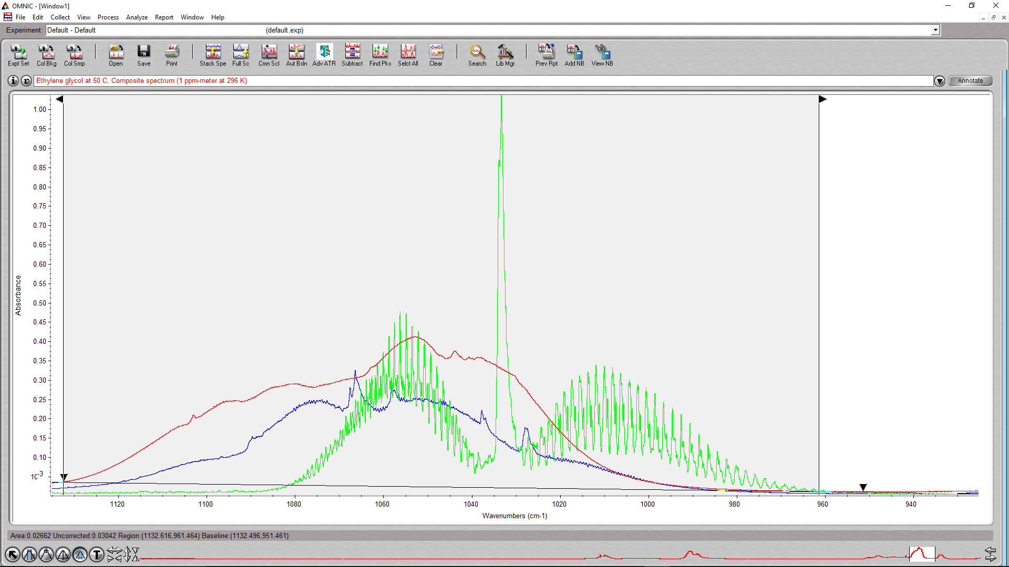
Ethylene Glycol vs. Surrogates Ethanol or Methanol at 50 C
(same pathlength * concentration)
~1500 * P_{vap}(CH₂OH)₂ = P_{vap}(CH₃OH)
~750 * P_{vap}(CH₂OH)₂ = P_{vap}(C₂H₅OH)
∫A_{(CH2OH)2} = 1.6 * ∫A_{C2H5OH} = 1.5 * ∫A_{CH3OH}
*Surrogate suitability:
EtOH >> MeOH

Slide 8
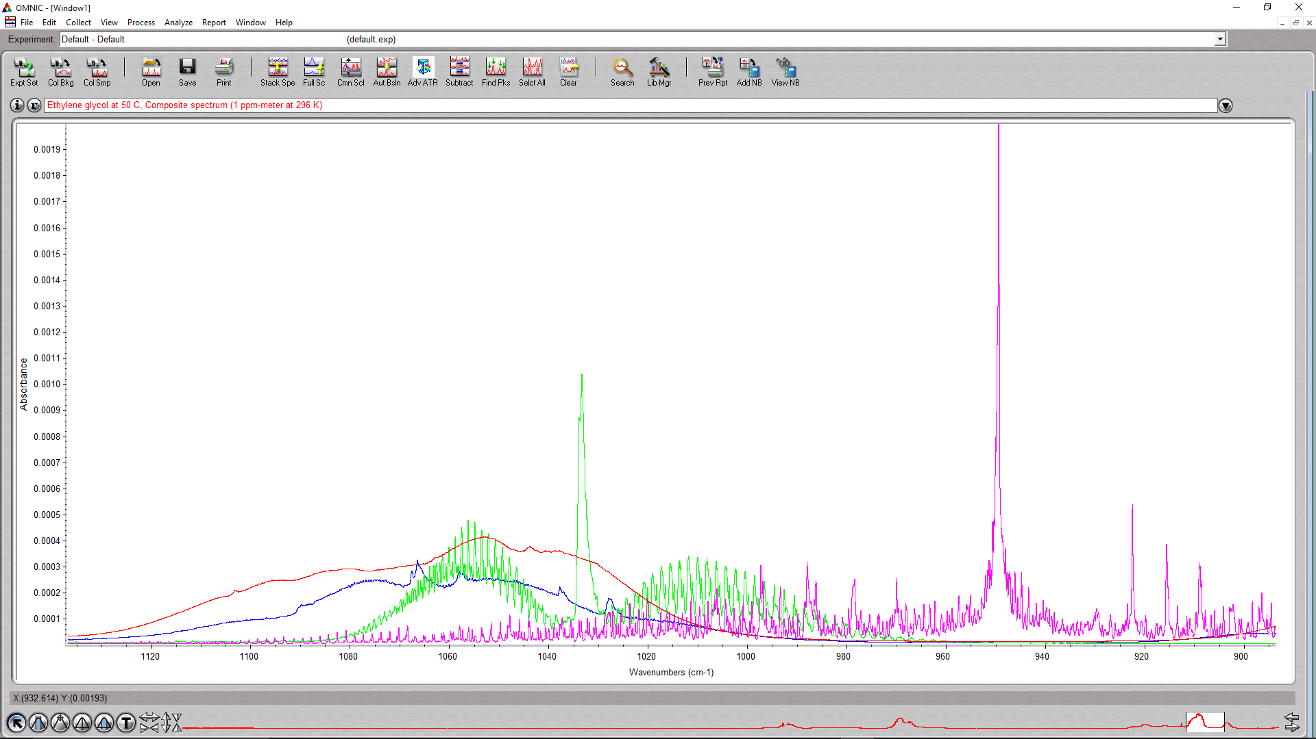
How about considering Ethylene as a spectroscopic surrogate?
*Non-suitable surrogate due to spectral dissimilarities and likely out of analysis region

Slide 9
So Which DL Determination Method Should be Used in Modeling/Emissions Inventories?
Not any pre-test instrument noise-limited MDLs
    These are a nice precursor to field testing, but certainly not field realistic
    Generally, FDLs will end up being 2 – 50 times pre-test MDLs
In order of relevance:
    Field verification of actual FDLs via analyte spiking methods
    Field verification of actual FDLs via analyte + surrogate spiking methods
      True surrogates are difficult to obtain, however
    Post-test estimates of MDLs using field spectra
      Note: This relies on accurate/traceable spectral calibrations!

Slide 10
Post-test Estimate of MDLs: Two Methods of Determination
Per ASTM D6348-12
  MDC#2 is calculated as such:
  Need > 8 independent field spectra
  Or, MDC#3 estimates are made based on averages of residual equivalent absorbances, REAs, in the field spectra; also known as CLS “residuals” or “errors”
    Basically, the absorbance left after the analysis routine have accounted for all analyte absorbances
Use the higher value as the most conservative MDL estimate

Slide 11
What’s the “Realistic” Field MDL, MDC#2 vs MDC#3?

Slide 12
Conclusions
With FTIR, there are usually distinct differences in its pre-test MDLs vs. FDLs because of spectroscopic interferences
    Because of the inherent variability of semiconductor emission sources in terms of process activity, number of pollutants, chemistry of pollutants, nature of aerosolized by-products
    Empirically determined FDLs are best, followed by post-test MDLs
If the treatment of analyte “zeroes” are a concern, the best course of action is to go into any emissions testing program with best achievable instrumentation configurations and quantitative analytical methods
In terms of test reporting, it is best to provide the entire “evolution” of DLs throughout: pre-test MDLs, validated FDLs, post-test MDLs per ASTM D6348-12
The data treatments and interpretations described here can, and should, be applied to real-time measurement methods other than FTIR

